Slide 1
Figure Workflow: Matlab to Latex
How to make sufficiently nice figures as quickly as possible

Slide 2
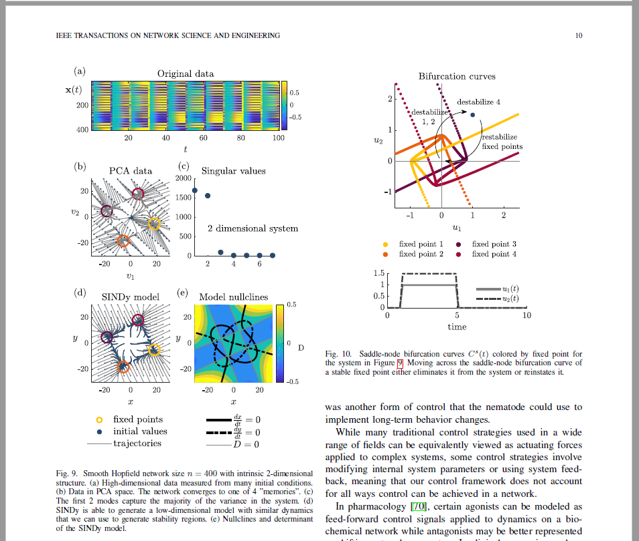
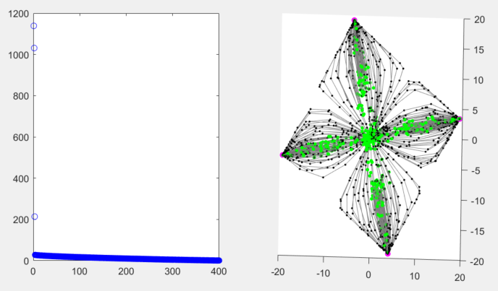
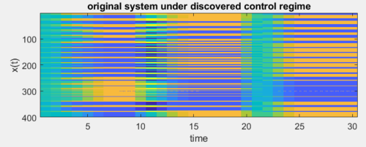
Initial Matlab figures
Final paper figures
Nice 2D system
Many,
many,
changes

Slide 3
What do we want in a figure?
Standardization: fonts, size, spacing, colors, etc...
QUICK and EASY to make changes
Easy to change file type: pdf, eps, png, …
Easy to use in different final products: paper, presentation, poster, dissertation, tutorial….
Quick to make the first time
Quick to change
No repeat work
Flexibility

Slide 4
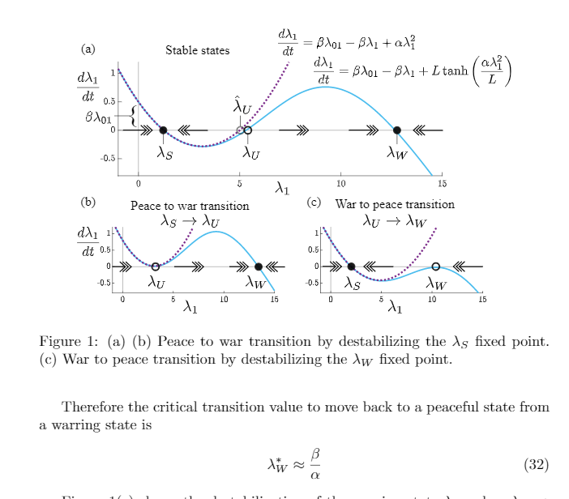

Slide 5
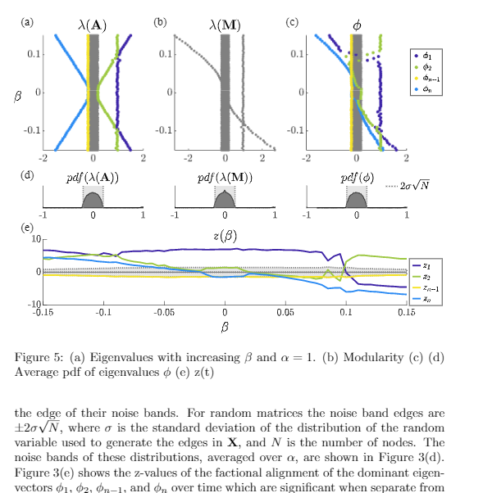

Slide 6
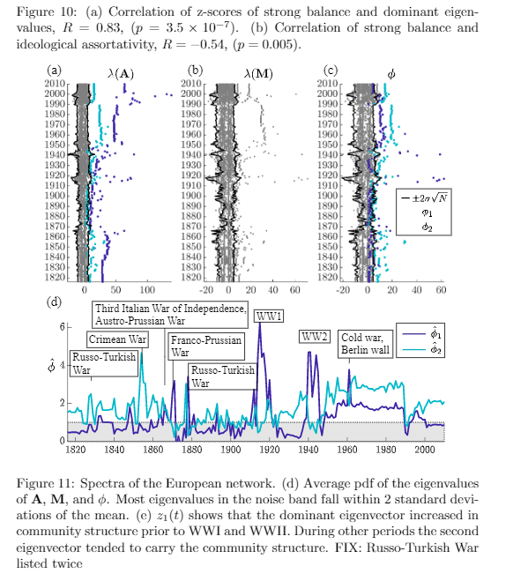

Slide 7
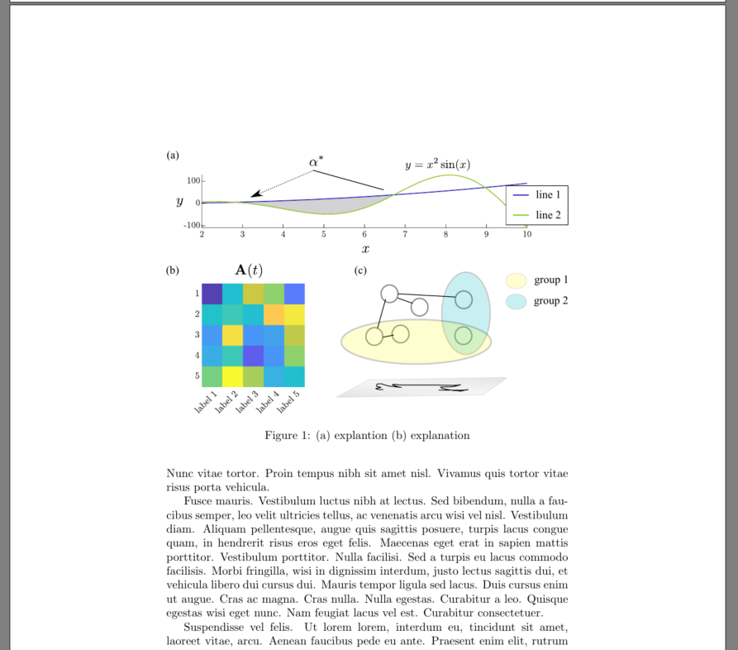
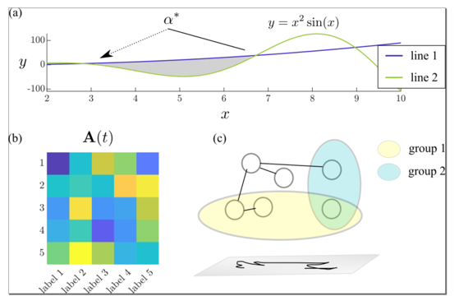
Workflow
Matlab,
Python,
R,
Mathematica
Inkscape
Latex
Insert final panel figure into latex file

Slide 8
Workflow
Matlab,
Python,
R,
Mathematica
Inkscape
Latex
Insert final panel figure into latex file
Generate and save INDIVIDUAL bare bones figures as pdfs (or eps) at a RESONABLE RESOLUTION
Set all….
Figure SIZES
Figure tick VALUES, SIZES, FONTS
Plot colors, linewidths
DON’T: combine multiple figures using subplots, add titles, x or y labels
Import bare bones figures
Create panel
Add all…
Labels
Annotations,
Legends,
Arrows,
Shapes,
Cartoons,
Anything else you want in final latex figure
Save panel as pdf,
ex) “demo_fig.pdf”
\begin{figure}
\centering
\includegraphics[width=1.0\linewidth]
{figures/demo_fig.pdf}
\caption{(a) blah blah blah (b) blah..} \label{fig:demo}
\end{figure}
DON’T: add any code to add stuff to figure or combine figures,
DON’T: use TikZ, Overpick, subfig package. Do everything you need to do in Inkscape

Slide 10
Data organization
Project Folder
Paper.tex
Make_figures.m
Figures folder
Sub_fig2.pdf
Sub_fig1.pdf
Sub_fig3.pdf
Mega_figure.svg
Mega_figure.pdf

Slide 11
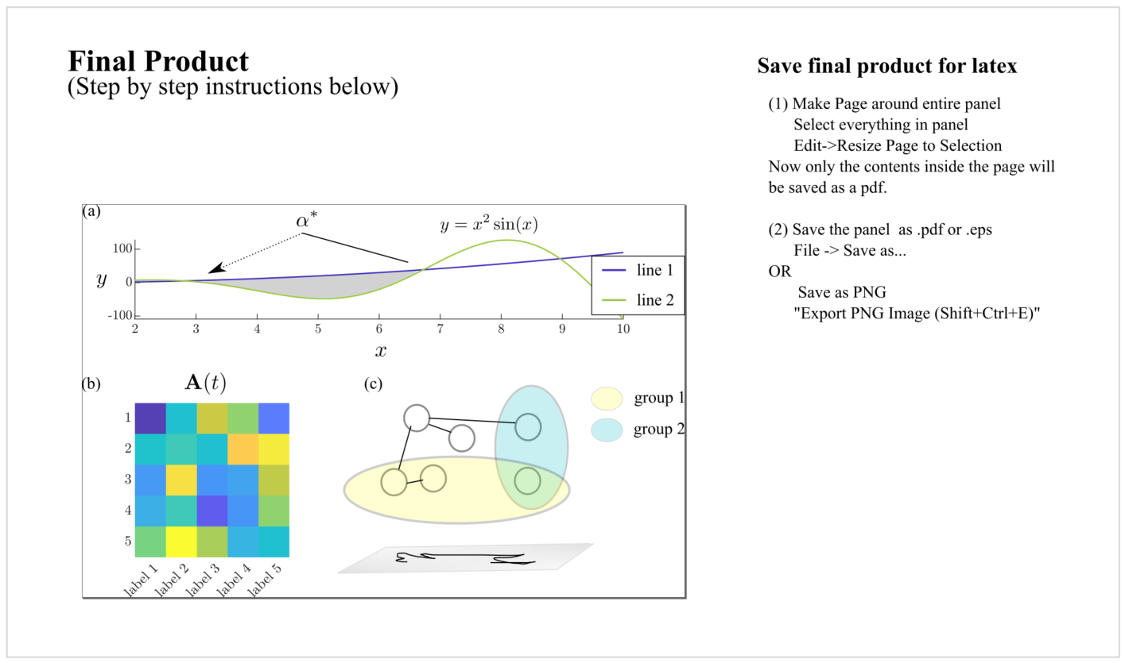

Slide 12
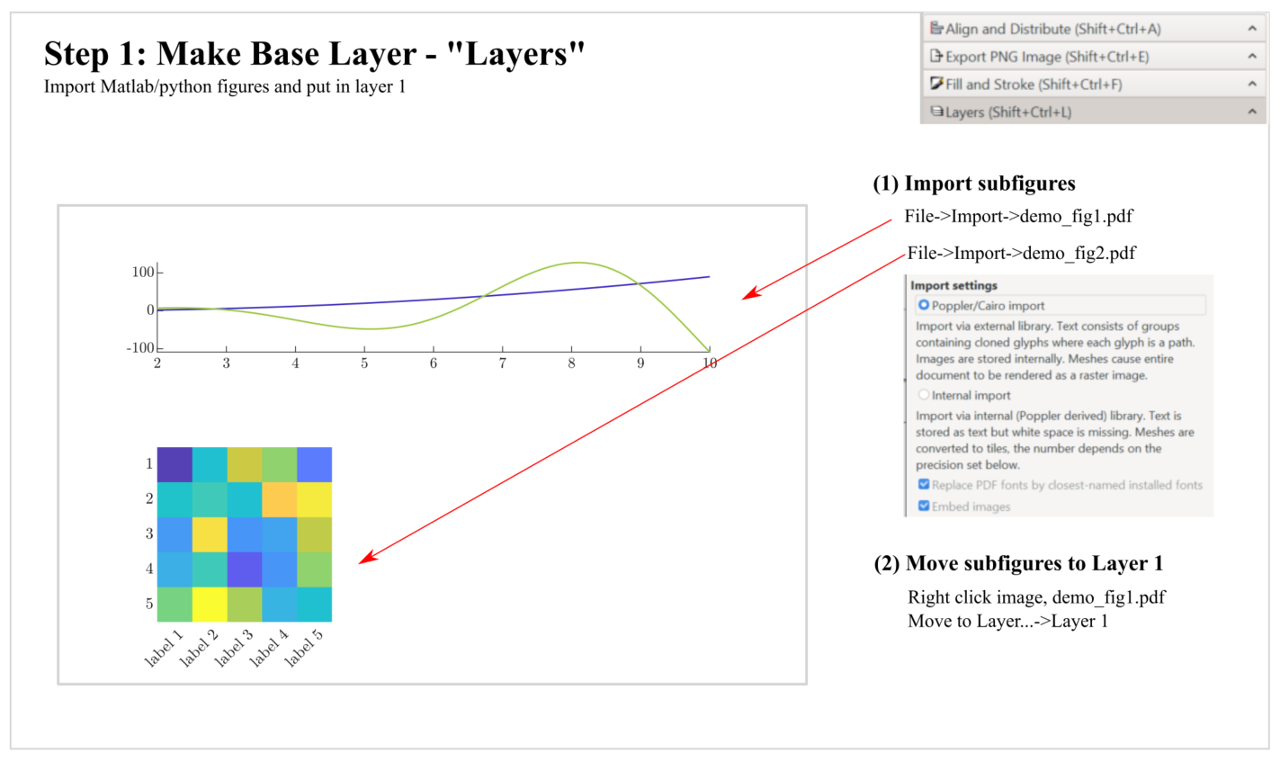

Slide 13
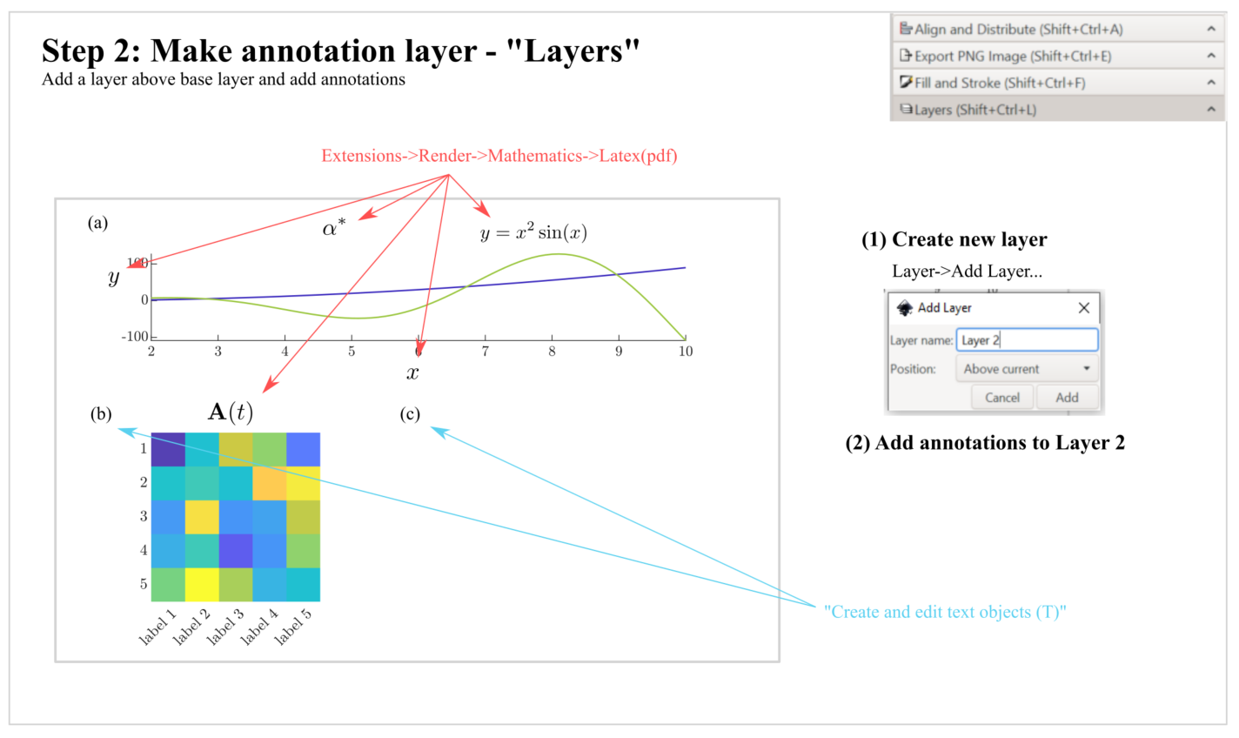

Slide 14
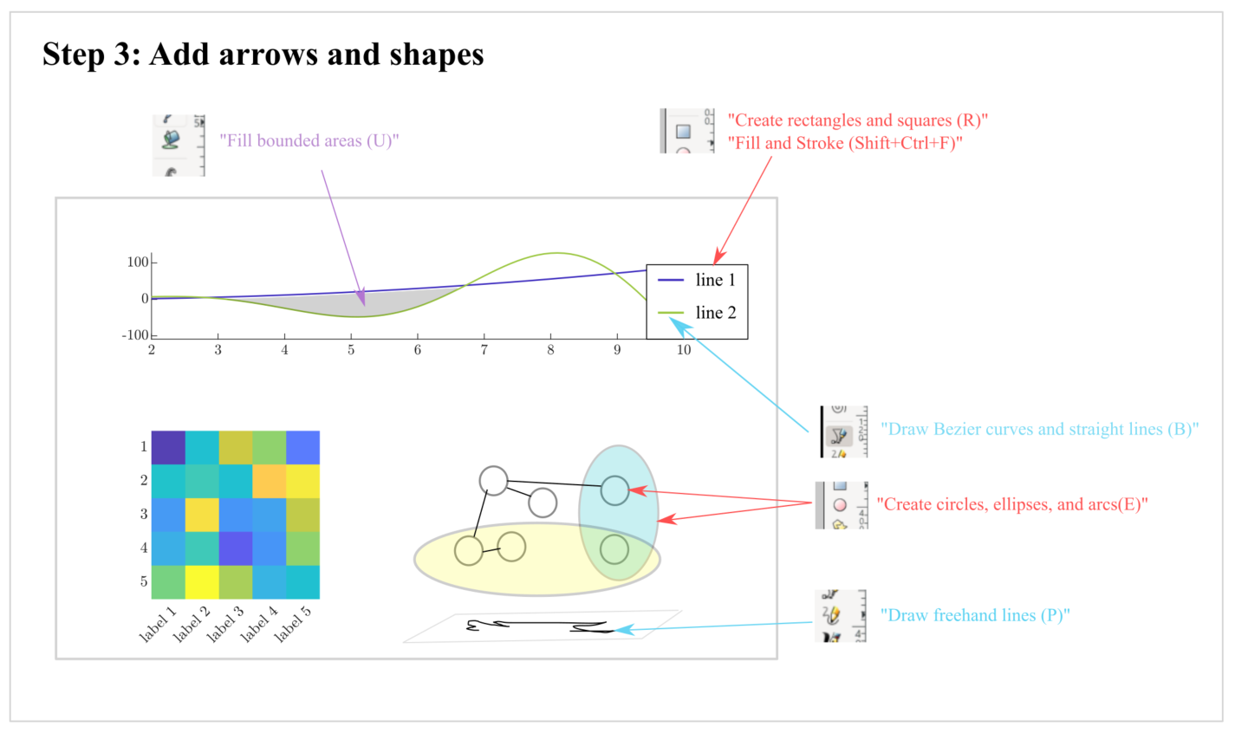

Slide 15
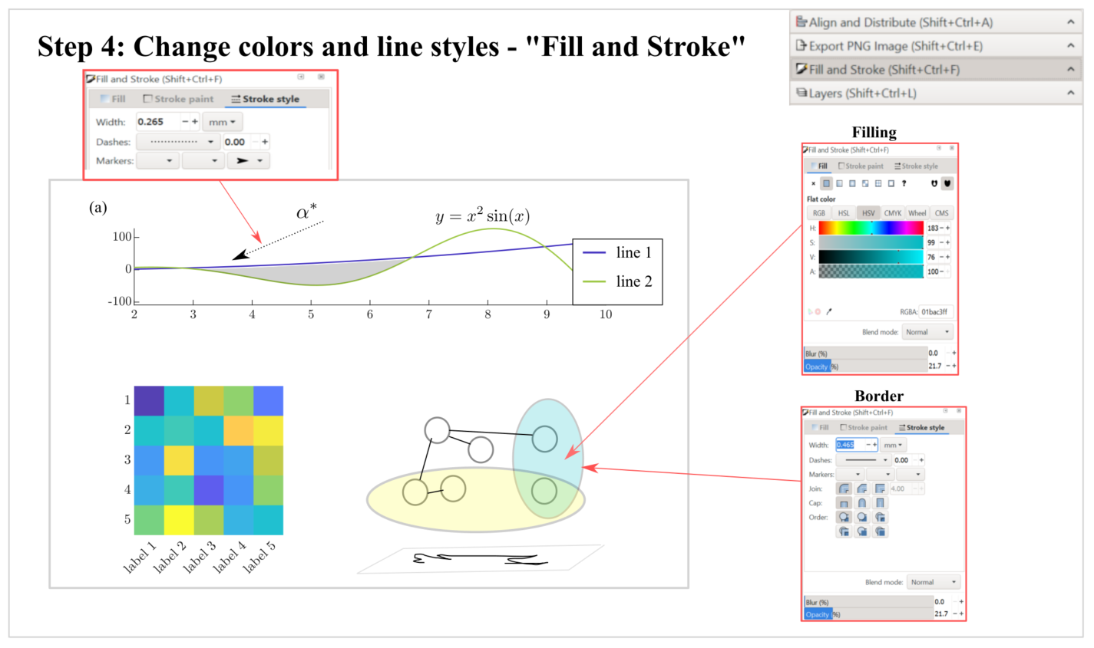

Slide 16
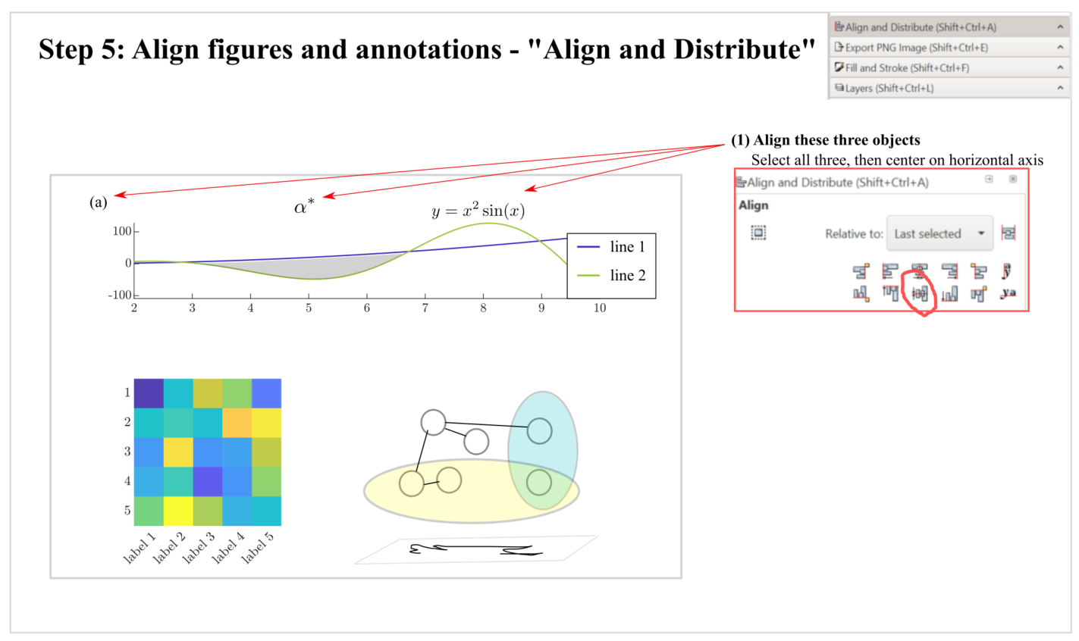

Slide 17
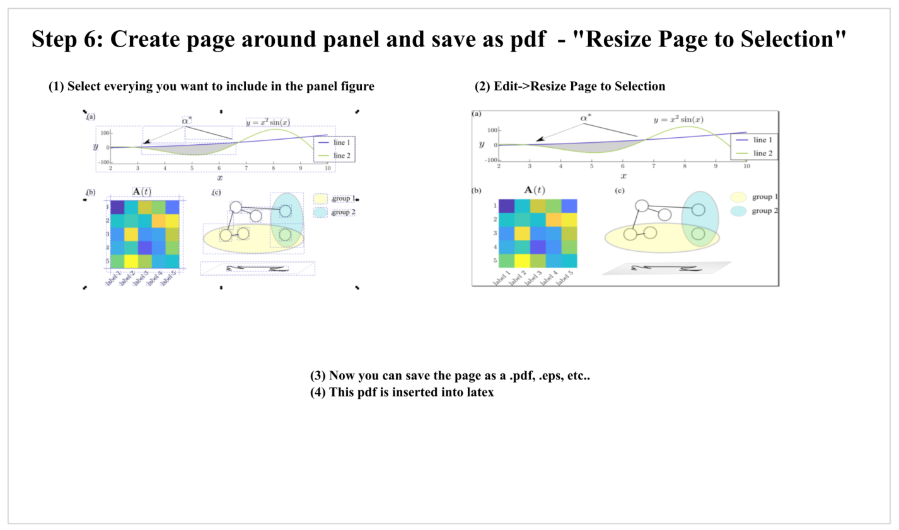

Slide 18
Call figure in latex
\begin{figure}
\centering
\includegraphics[width=1.0\linewidth]
{figures/demo_panel.pdf}
\caption{(a) explanation
(b) explanation}
\label{fig:demo_panel}
\end{figure}

